Slide 1





CS1 North Gujarat simulpast.imf.csic.es/wiki/index.php/CS1
SimulPast third plenary workshop

Slide 2
Structure of the talk
Aims
Entities
Climate
Environment
Agents
Results
Issues and possible solutions
Open discussion

Slide 3
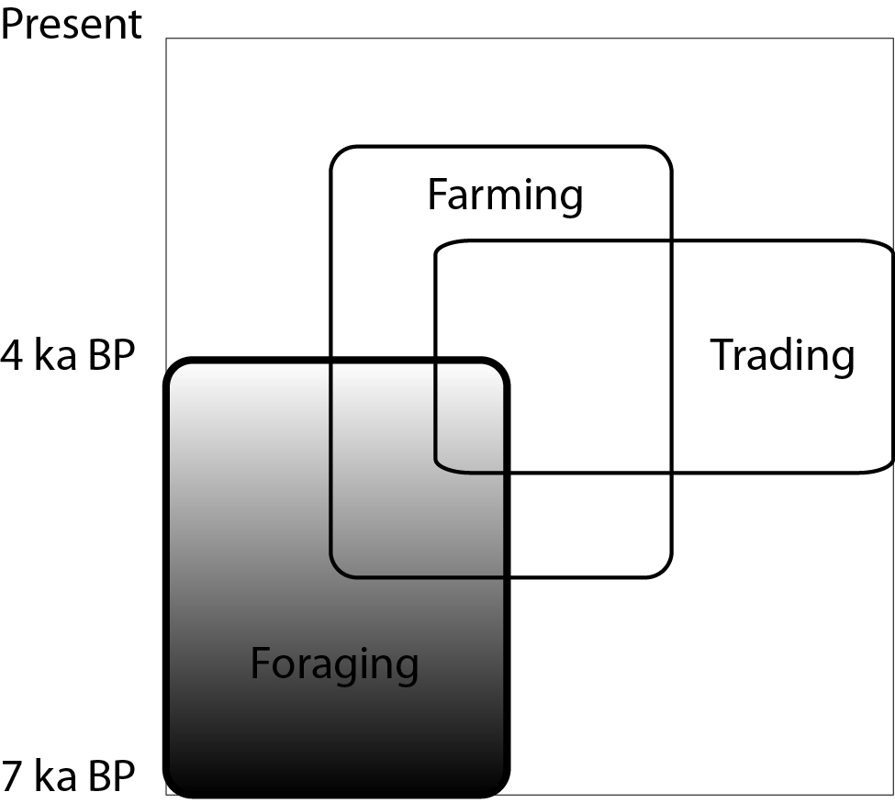
Aim of the model
Explore H-G resilience in semi-arid environments
Model is inspired on archaeological issues (long time presence of HG in Gujarat) and fed with anthropological, climatic, archaeological knowledge
Model focuses on socio-ecological behavior

Slide 4
Model entities
Climate
  Precipitation
  Three seasons modeled from historical data
Environment
  Ground model modeled from satellite imagery
  Biomass modeled from present-day biomass production for semi-arid regions
Agents
  Nuclear family composition modeled from anthropological literature
  Requirements modeled from FAO global reports

Slide 5
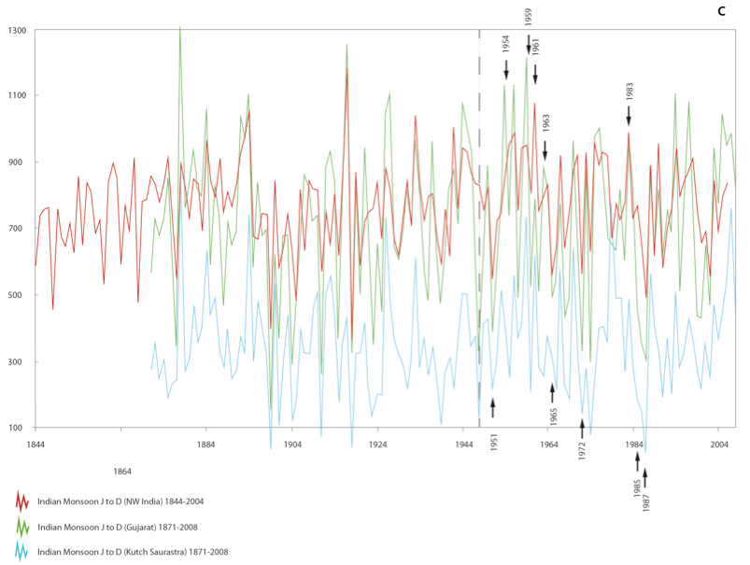
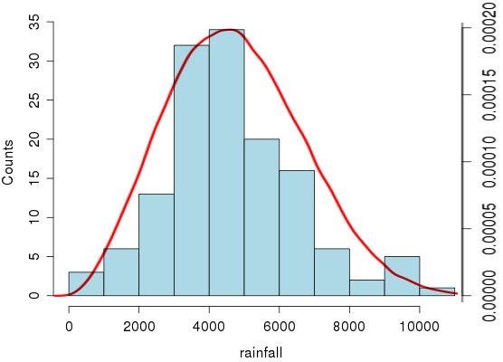
Climate 1/2
Precipitation
Historical record
Weibull distribution

Slide 6
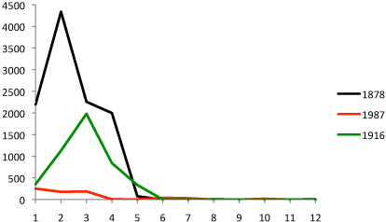
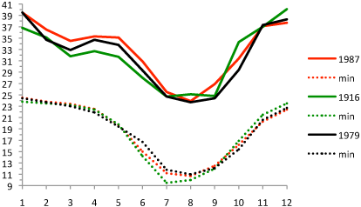
Climate 2/2
Precipitation
JJAS
ONDJ
FMAM

Slide 7
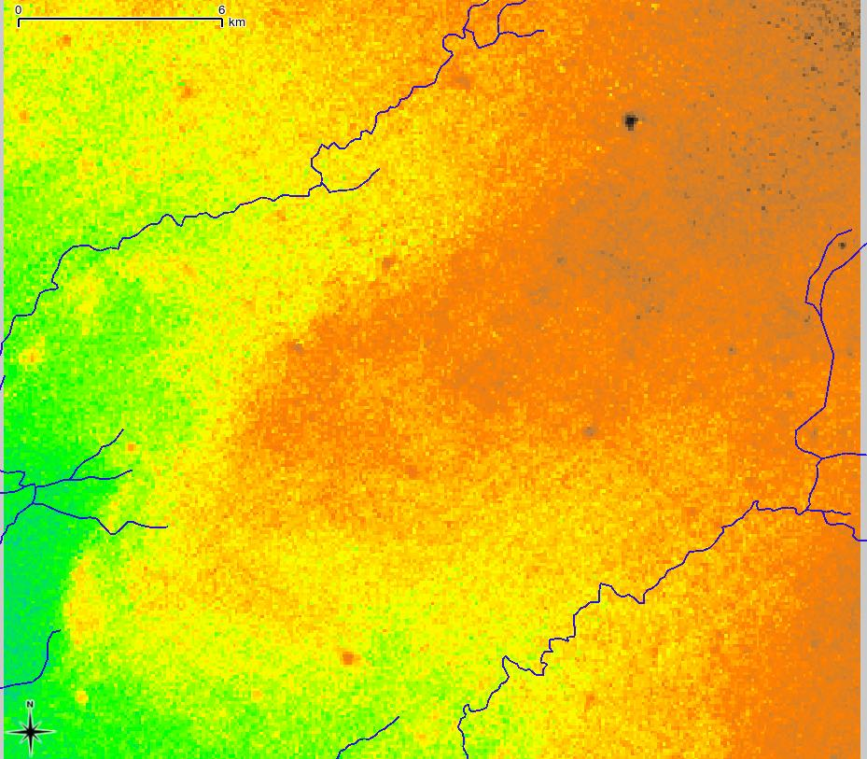
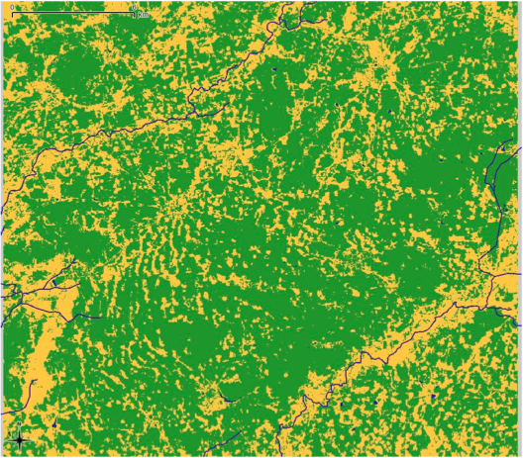
Environment 1/2
Ground model (cells are 31.5x31.5 m = 800x800 cells = 625 km2):
  Dunes (settlement allowed)
  Interdunes (biomass concentration)
  Water (no settlement, no biomass)
DEM
Soil units

Slide 8
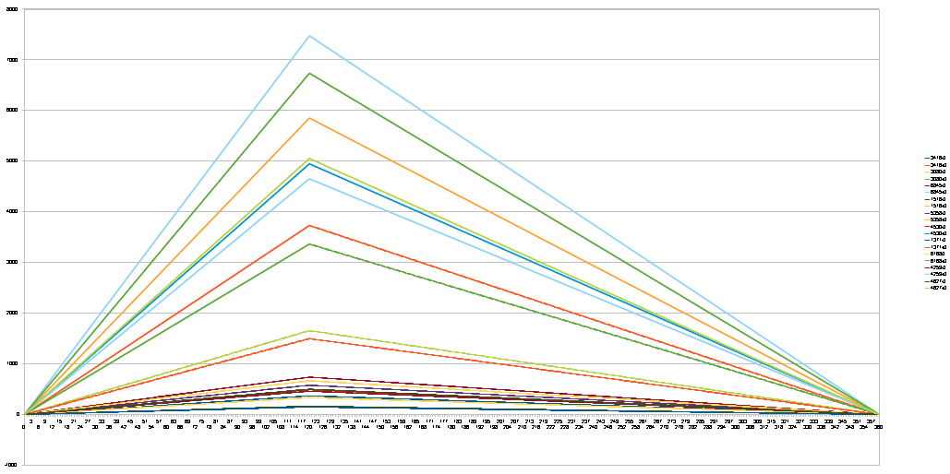
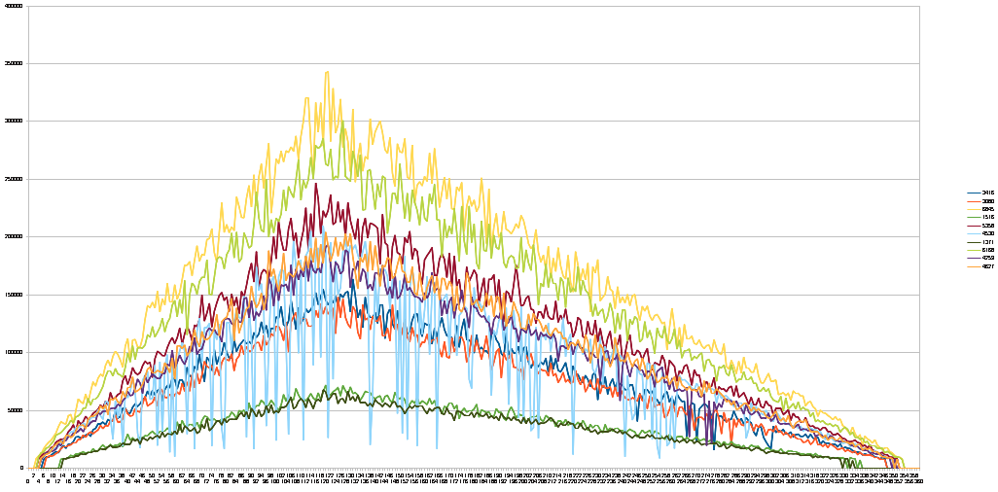
Environment 2/2
Precipitation to biomass conversion:
  Precipitation derived from climate engine
  Total biomass derived from precipitation
  Biomass distribution homogeneous in interdunal areas
Biomass distribution
Gathering behavior
Primary biomass is derived from present-day semi-arid environments

Slide 9
Agents 1/5
The demographic model has been implemented at an individual/year level:
  Reproduction – If the couple is active and able to, will reproduce with 50% probability.
  Agent creation – If an agent has children with age > adulthood age it will look for another agent in similar condition. If it is met, a new agent will be created with these two individuals.
The metabolism of the agents is also modelled after individuals:
  Each individual consumes 2.000 calories x day
  Adults will contribute 4.5 hours of workforce x day
  Offsprings that have not arrived to adulthood age will not contribute any workforce.

Slide 10
Agents 2/5
Life expectancy - A mortality check is made every year for every individual:
    10% mortality from 0 to 2 years
    2% mortality from 3 to ? years
Survival – Added to the basic mortality there is another check that is related to the success of the agent on getting the required resources:
    % death = 100 x days without resources / days x year

Slide 11
Agents 3/5

Slide 12
Agents 4/5
Each day an agent will execute an action:
  Forage – An action that uses the available workforce to gather resources
    Hunting & Gathering are not differentiated because it is a semiclosed system (no animal migration)
  Move home – The agent's camp is moved to another zone
    A forage action is executed using half workforce
Forage Range
Sector 8
Sector 1
Sector 7
Sector 2
Sector 6
Sector 3
Sector 5
Sector 4

Slide 13
Agents 5/5
Strategies – We have defined three different strategies for the decision-making processes of the agents:
  Random behaviour – Useful for testing null hypothesis
  Wired algorithm – Classic Agent-Based Modelling approach
  Model-Based Agent – Agents plan their actions in relation to goals and costs

Slide 14
Agents 5/5/a
Random agent
  An agent will choose Forage Action 80% of the time steps
  The sector to forage is also randomly chosen
  Move Action will randomly choose a suitable area for the new camp from all available options

Slide 15
Agents 5/5/b
Wired agent algorithm
If the richest sector contains twice the value of required needs:
Forage richest sector
Else
Forage richest sector and move to a place with more resources

Slide 16
Agents 5/5/c/1
Model-Based Agent
For every time step an agent will:
  Update knowledge
  Build a model of their environment
  Construct a plan of actions to achieve a goal (improve starvation rating)
  Simulate the effects of the different actions and choose the best action

Slide 17
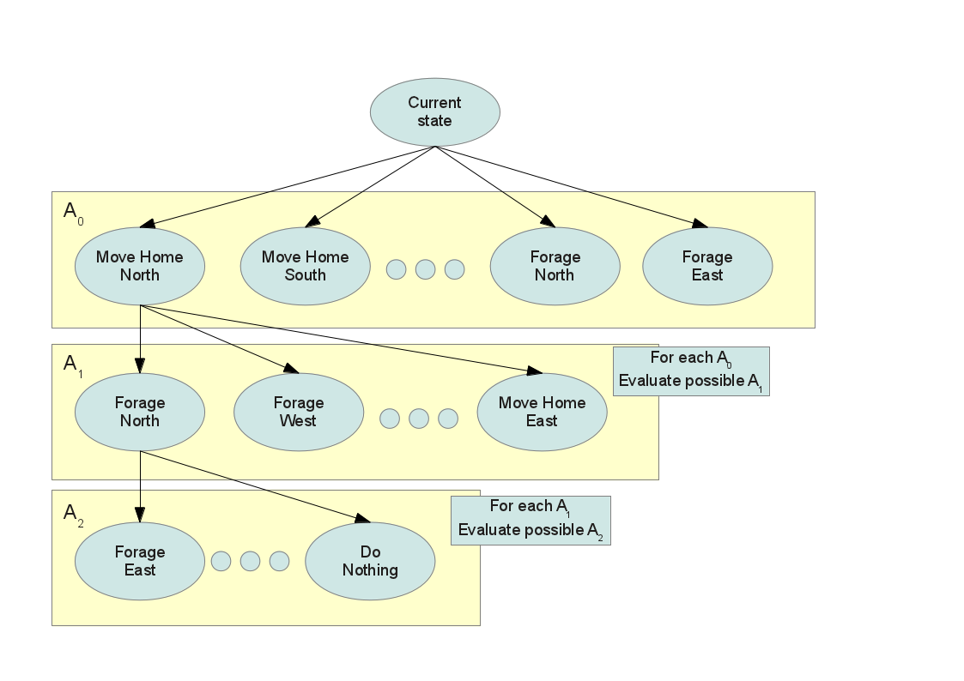
Agents 5/5/c/2

Slide 18
Results 1/7
Survival - Preliminary results show that the system “lives” constantly on the edge of collapse:
  Starvation rates are extremely high due to a month of scarce resources
  Mid-term extinction (30-40 years) is almost impossible to avoid

Slide 19
Results 2/7
The system can not survive with more than 2% yearly starvation

Slide 20
Results 3/7

Slide 21
Results 4/7
The impact of “bad” years and the high variability of the rain are responsible for these results

Slide 22
Results 5/7

Slide 23
Results 6/7

Slide 24
Results 7/7
Mobility
  Wired agents will not move for most part of the year if scale is correct
  Mobility was used on the first sets of runs, which used 1/5 of the real foraging range
  It is not a problem of the agent's behavior, because the Model-Based Agents never chooses Move Home Action
Do they need to move?
  A sector contains around 50.000 cells of homogeneously distributed resources
  Each individual can forage 9 cells in a day (spending 0.5 hours x cell)
  An agent will spend 123 years foraging before repeating a cell

Slide 25
Issues and possible solutions 1/8
Offsprings:
    From 0 to 15 years the offsprings are increasing their metabolic needs following a linear progression (from 600 to 2200 kcal)
    From 5 to 15 years the offsprings are increasing they foraging capacity to adulthood standards also following a linear progression (‘learning’ module)

Slide 26
Issues and possible solutions 2/8
Life expectancy without starvation is too short at 25 years.
We have adjusted the adult mortality check from 2% to 1.5% to shift life expectancy to a more real 35 years.

Slide 27
Issues and possible solutions 3/8
Mobility
  Possible modifications:
    Climate (discarded)
    Environment (presently homogeneous distribution of resources in interdune areas)
    Agents (Model-Based agent is optimal)
  Ground model needs to be refined to allow for redistribution of biomass (e.g. using water as an attractor)
    First simplified model based on linear distribution of biomass with higher concentrations near water bodies
    Work in progress: DEM derived from CORONA satellite imagery

Slide 28
Issues and possible solutions 4/8
Linear or logarithmic decrease of resources directly related with cell distance to water
The total resources are the same as in previous distribution pattern

Slide 29
Issues and possible solutions 5/8

Slide 30
Issues and possible solutions 6/8

Slide 31
Issues and possible solutions 7/8

Slide 32
Issues and possible solutions 8/8

Slide 33
Discussion 1/1
Survival
  Offsprings
    0-15 y.o. linear increase of metabolic needs, from 600 to 2200 kcal
    5-15 y.o. linear increase of foraging capacity to adulthood standards
    (‘learning’).
  Mid-term extinction: discuss new observed trends
  Life expectancy: discuss change from 25 to 35 years (from 2% to 1.5%
    mortality check)
Mobility: discuss possible modifications:
    Climate (discarded)
    Agents (discarded)
    Environment (OK): ground model needs to be refined to allow for more accurate of biomass (e.g. using water as an attractor)
    Preliminary model based on linear distribution of biomass with higher concentrations near water bodies
    Work in progress: DEM derived from CORONA satellite imagery

Slide 34
Future implementations 1/1
Stress
Social networks
  Kinship/acquaintance
  Ask/give
Cultural transmission
  Information
  Learning
Agro-Pastoralists
  Resilience
  Interaction

